Slide 1
Meme Analytics Bot
AI -powered Meme Scraping, Analysis & Reporting
By: Shaune Ang

Slide 2
Guiding Objective
Give creators an insight for them to have the best chance of getting popular

Slide 3
Table of contents
1
2
3
4
5
6
7
Key Decisions
System Overview
Techstack
Core Features
Report Content
Challenges and Pitfalls
Future Improvements

Slide 4
Key Decisions
Fetching Frequency
NoSQL Database
Popularity Metric
Once every hour to obtain an even spread of data
Flexible semi-structured data
Quick implementation
Up vote count used to determine popularity

Slide 5
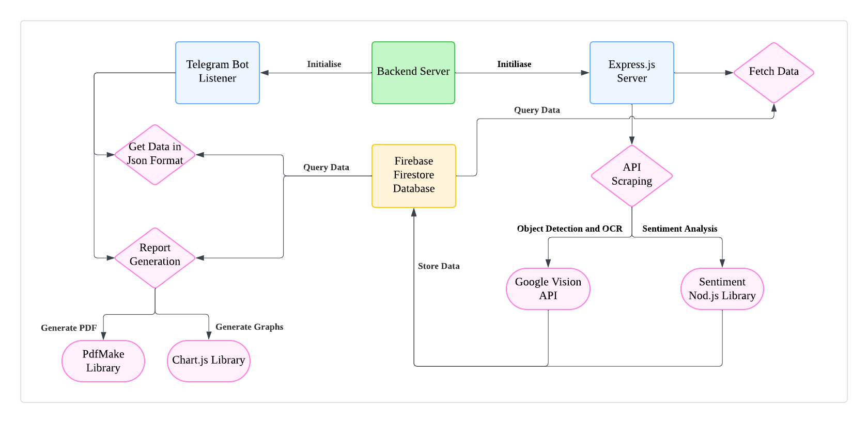
System Overview

Slide 6
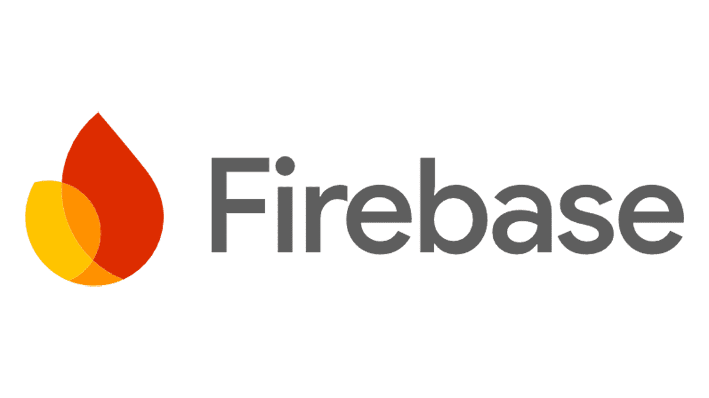



Techstack
Backend | Purpose
Node.js + Express.js | Backend API & server logic
Firebase Firestore | NoSQL database for meme storage
Reddit API | Fetching trending memes
Analysis | Purpose
Google Vision AI | Image recognition & OCR
Sentiment | Sentiment analysis
Compromise NLP | Text analysis & keyword extraction
Report | Purpose
Chart.js + ChartJS Node Canvas | Data visualization
pdfmake | PDF report generation
Telegram Bot API | User interaction

Slide 7
Core Features
Divide the class into small groups of 3-5 students. Assign each group a real-life application for which they will have to use math concepts to solve
Periodically Scrape Memes
1
2
Graph-Based Insights & Trends
Up to date database
Meme popularity over time
Vote ratios & comment trends
Text & image correlation
Topics
Telegram Report Generation
3
4
AI & NLP Meme Analysis
Easy user interaction
Image Text Extraction (OCR)
Sentiment & Keyword Analysis
Object Detection

Slide 8
Report Content
Section | Purpose
Top Voted Memes | Overall statistics on the top 20 up voted memes. With information such as Author, Upvotes, Downvotes, Upvote Ratio, Comments.
Ranked Meme Creators | To highlight whether there are creators that are consistently on top, so that creators can follow these authors and try to emulate them.
Top Keywords Extracted | Shows any trending keywords that appear in top memes.
Meme Timestamp Distribution | Identifies peak meme activity hours and the best times to post for maximum engagement.
Comments vs. Upvotes | Determine if highly upvoted memes also attract more discussion, indicating higher engagement
Votes vs. Upvote Ratio | Determine if highly voted memes are well-received or controversial
Post Format Distribution | Track which meme formats are most popular and how users engage with different media types
Sentiment Distribution | Analyse whether trending memes are uplifting, controversial, or neutral in tone.

Slide 9
Challenges and Pitfalls
Categorisation of Memes
OCR for Image Text Inaccurate
Keyword Extraction Relevance
Difficult to categorise memes based on individual pieces of information (e.g. image, text, OCR)
Solution:
Use CLIP to train a model to detect meme categories based on multiple inputs
When using Tesseract OCR for recognising the text in images, there were inaccuracies in extracted text. Solution:
Tested with Google Vision API and used it instead
Keywords extracted from OCR and Title were not very relevant
Solution:
Used Google Vision API’s Object Detection to detect objects in the image instead
Additional Remedy: Reprocess keywords before storing

Slide 10
Future Developments
Categorical Analysis of Top Performing Memes
Web dashboard with interactive meme analytics, live charts and data
These are some developments that could have been made given more time.
1
2

Slide 11
Thank you!
AI -powered Meme Scraping, Analysis & Reporting
By: Shaune Ang

